Slide 1
Computer-Assisted Text Analysis for Social Science: Topic Models & Beyond
Ryan Wesslen, PhD Computer Science Qualifying Exam
Notes:
1

Slide 2
Overview
Topic Model Evolution
Overview
LDA and Seminal Papers
Explaining & Applying Topic Models
Interpretation & Evaluation
Visual Analytics
Social Science Applications
Social Science Applications
Structural Topic Modeling & Multi-Modality

Slide 3
Topic Model Overview

Slide 4
Research Problem
How to analyze large collections of text for social science applications?
Computer scientists pioneered topic models
Latent Dirichlet Allocation (LDA)
Topic models are now expanding to social sciences:
Open source, high-level tools (R, Python)
Rise in digital content (social media, website)
New extensions to include document-covariates (STM)

Slide 5
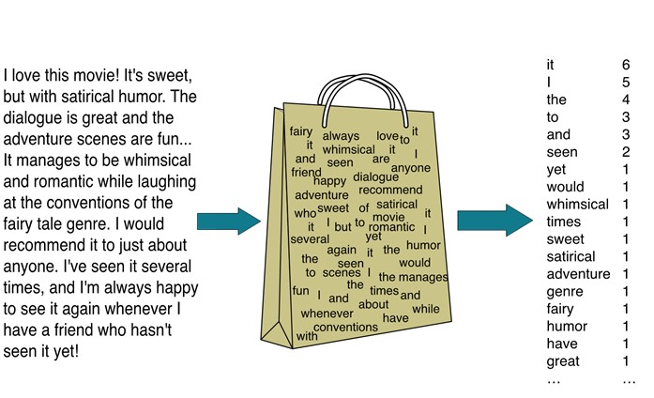
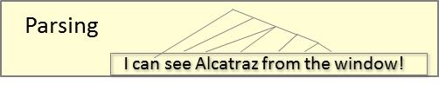
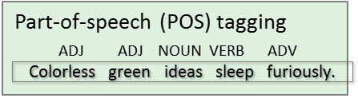
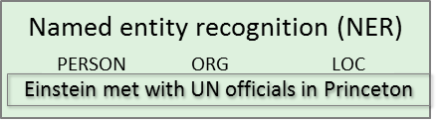
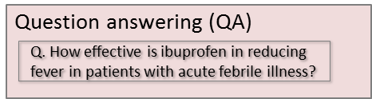
Text Analysis
Text Analysis
Natural Language Processing
Bag-of-Words (Statistical-based)
Supervised
Unsupervised
Topic Modeling
Overgeneralization for illustrative purposes
Graphics by Dan Jurafsky, Chris Manning

Slide 6
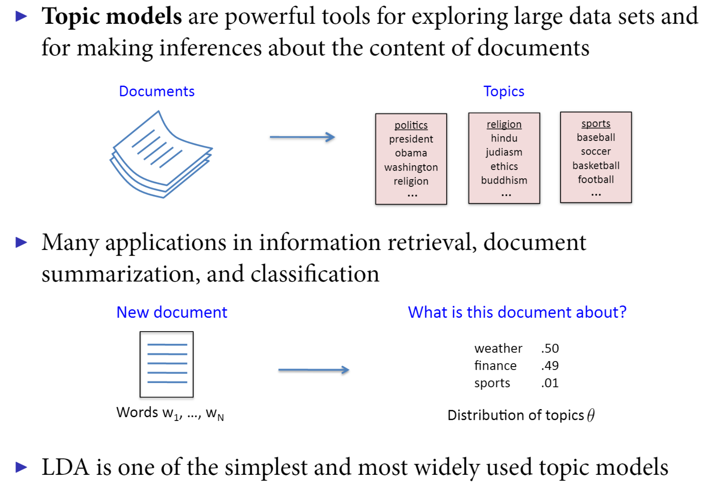
Topic Modeling / Latent Dirichlet Allocation (LDA)
Source: Pablo Barberá
Notes:
No covariates
No correlation
Multimodality (initialization problem)
6

Slide 7
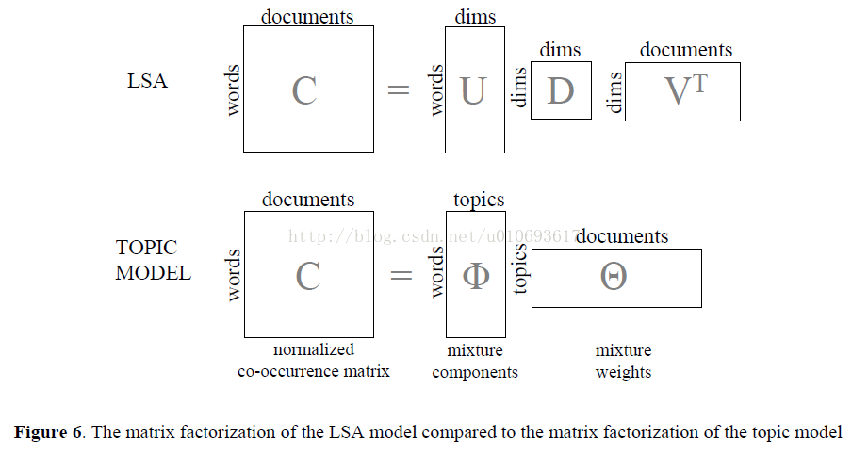
LDA and Seminal Models (LSA, pLSI)

Slide 8
Computational Methods
Intractability Inference Problem
Consequence of Bayesian mixture (probabilistic) model
Topic model inference is NP-hard problem (Arora et al 2012)
Simulation (Sampling-based methods)
Gibbs Sampling, Markov Chain Monte Carlo
Unbiased but potentially slow
Mean Field Variational Inference
Approximation of actual posterior
Converts to optimization problem
Only option for large-scale (online) methods

Slide 9
Explaining & Applying Topic Models
How to incorporate covariates?
How to evaluate models?
How to interpret topics?

Slide 10
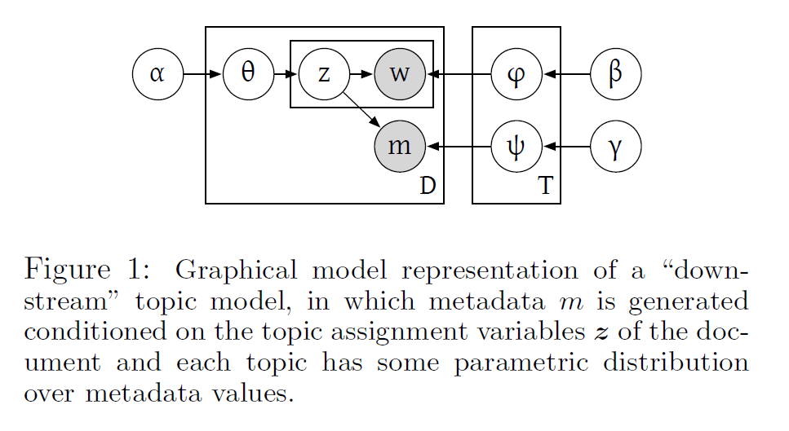
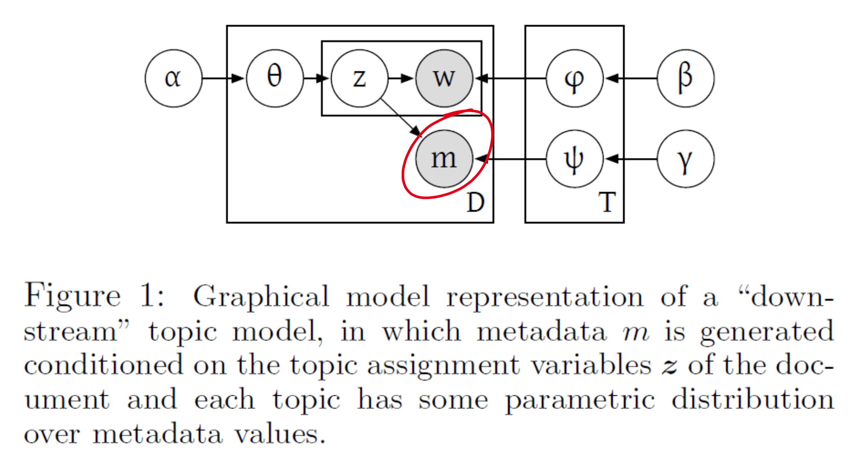
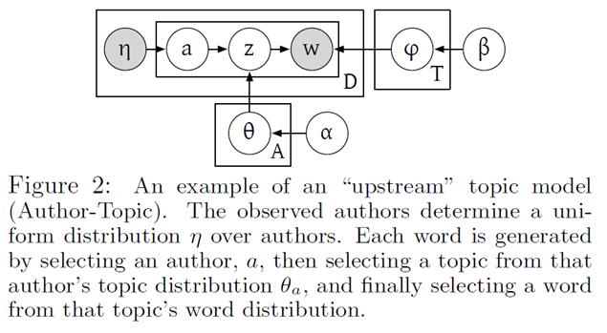
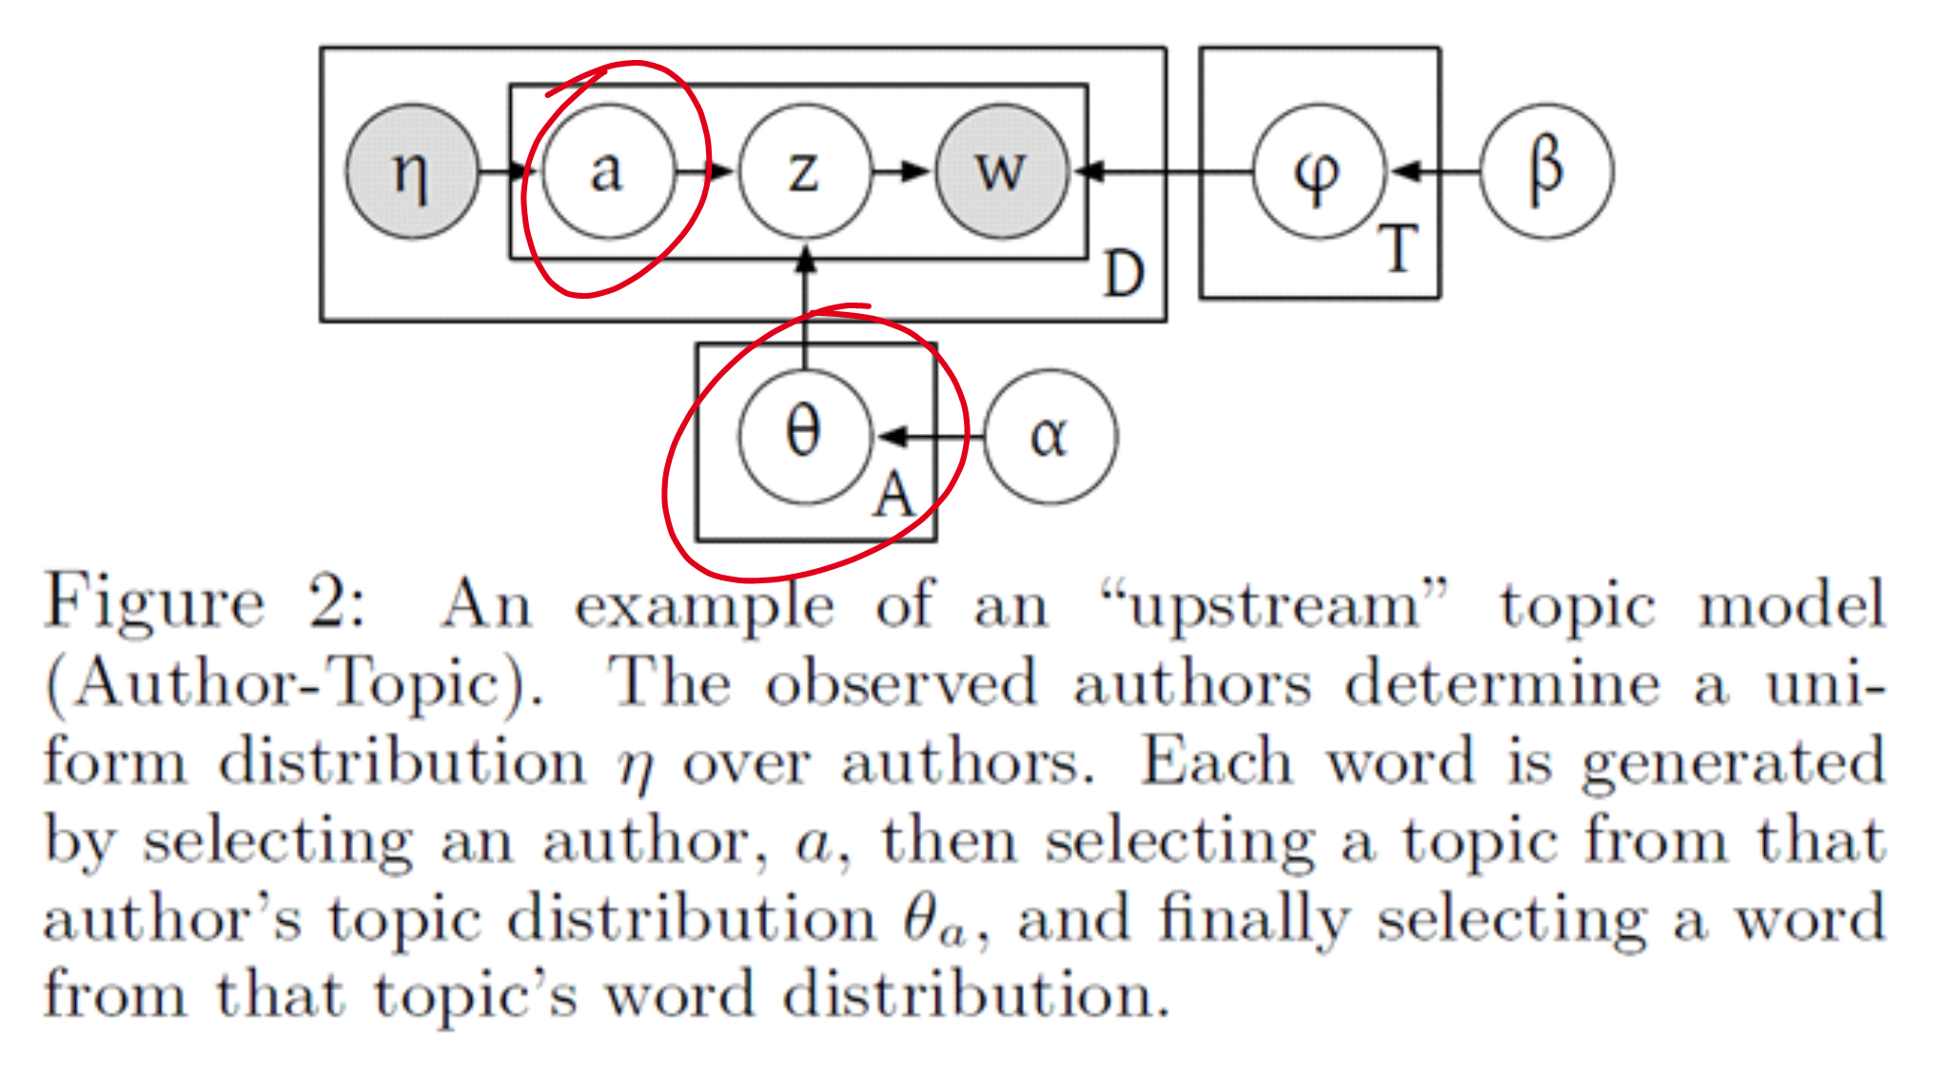
Model Extensions: Include Document Metadata (covariates)
Down-stream: Metadata is an “output” of the topics (z)
Example: User Ratings
Supervised LDA: Blei & McAuliffe (2007)
Up-stream: Metadata is an “input” to the topics (z)
Example: Author
Author-Topic: Rosen-Zvi et al. (2004)
Up-stream & Down-stream figures and introduced by Minmo & McCallum (2010)
Notes:
10

Slide 11
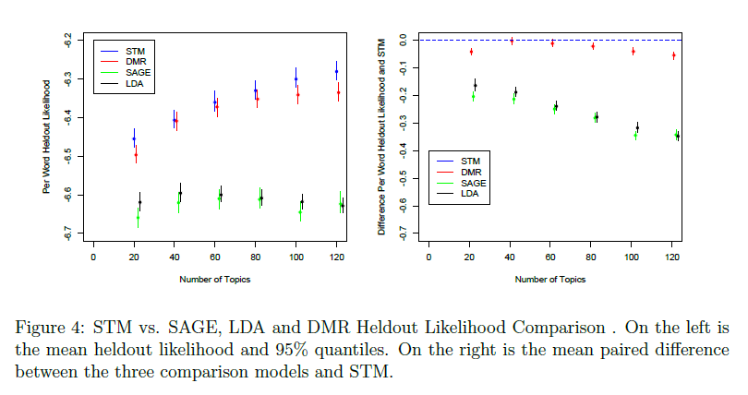
Model evaluation from a machine learning approach
Prediction of out-of-sample (heldout) dataset
Perplexity or Log-Likelihood with Cross-Validation
Wallach et al. 2009
Models with higher heldout likelihoods are “better”
Can also be used to determine the optimal number of topics, hyperparameter values.

Slide 12
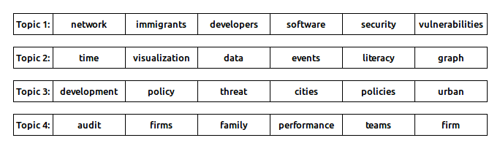
Interpretability-Prediction Tradeoff
Chang et al (2009) questioned conventional wisdom
Proposed word-intrusion tasks to find “intruder” word
Measure of “semantic cohesion”
UNCC Research Topics “Word Intrusion” Example
Contrary to expectation, prediction negatively correlates with topic interpretability.

Slide 13
Semantic Coherence & Exclusivity

Slide 14
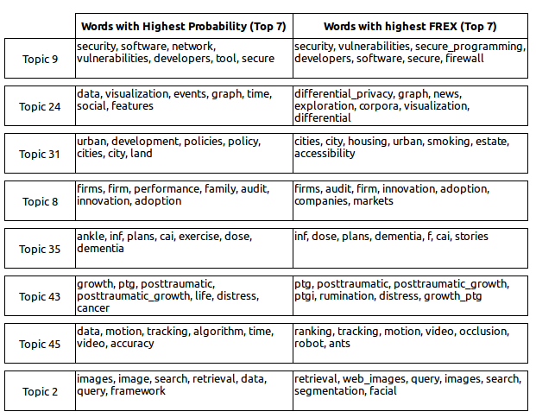
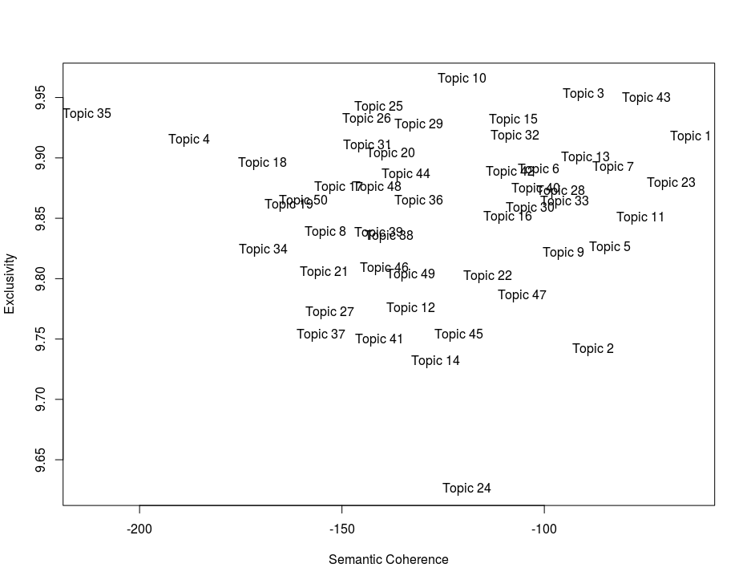
How to interpret topics?
Sample UNCC Research Topics
UNCC Research Topics: Exclusivity and Semantic Coherence
FREX/Exclusivity: Bischof and Airoldi (2012)
Semantic Coherence: Minmo et al. (2011)
Notes:
“Newman et al. (2010) capture topic interpretability using a more direct approach, by asking human users to rate topics (represented by their top-10 topic words) on a 3-point scale based on how coherent the topic words are (i.e. their observed coherence). They proposed several ways of automating the estimation of the observed coherence, and ultimately found that a simple method based on PMI term co-occurrence within a sliding context window over English Wikipedia produces the consistently best result, nearing levels of interannotator agreement over topics learnt from two distinct document collections.”
“Mimno et al. (2011) proposed a closely-related method for evaluating semantic coherence, replacing PMI with log conditional probability. Rather than using Wikipedia for sampling the word co-occurrence counts, Mimno et al. (2011) used the topic-modelled documents, and found that their measure correlates well with human judgements of observed coherence (where topics were rated in the same manner as Newman et al. (2010), based on a 3-point ordinal scale).”
14

Slide 15
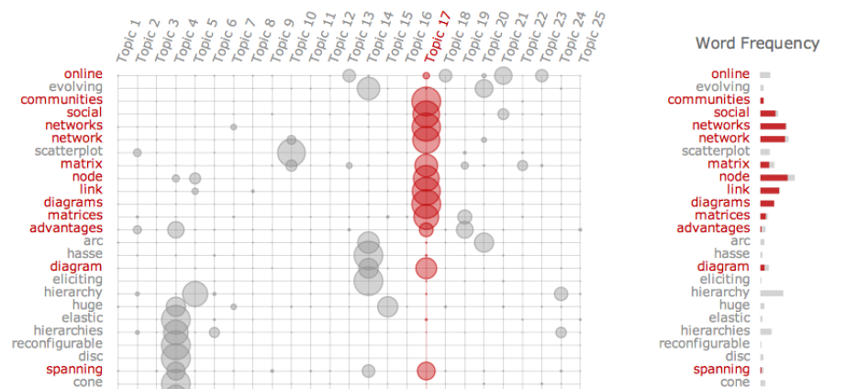
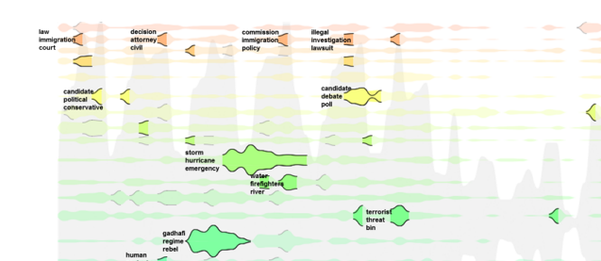
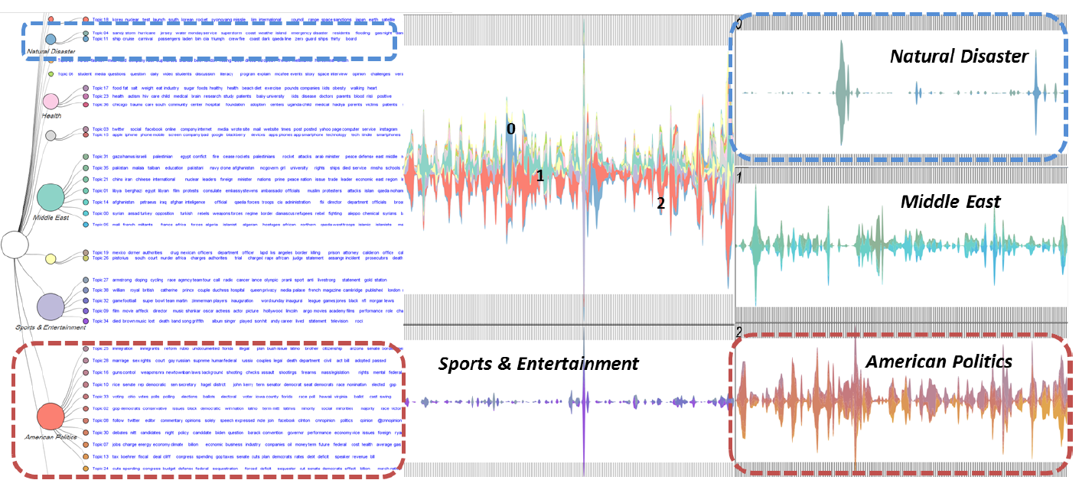
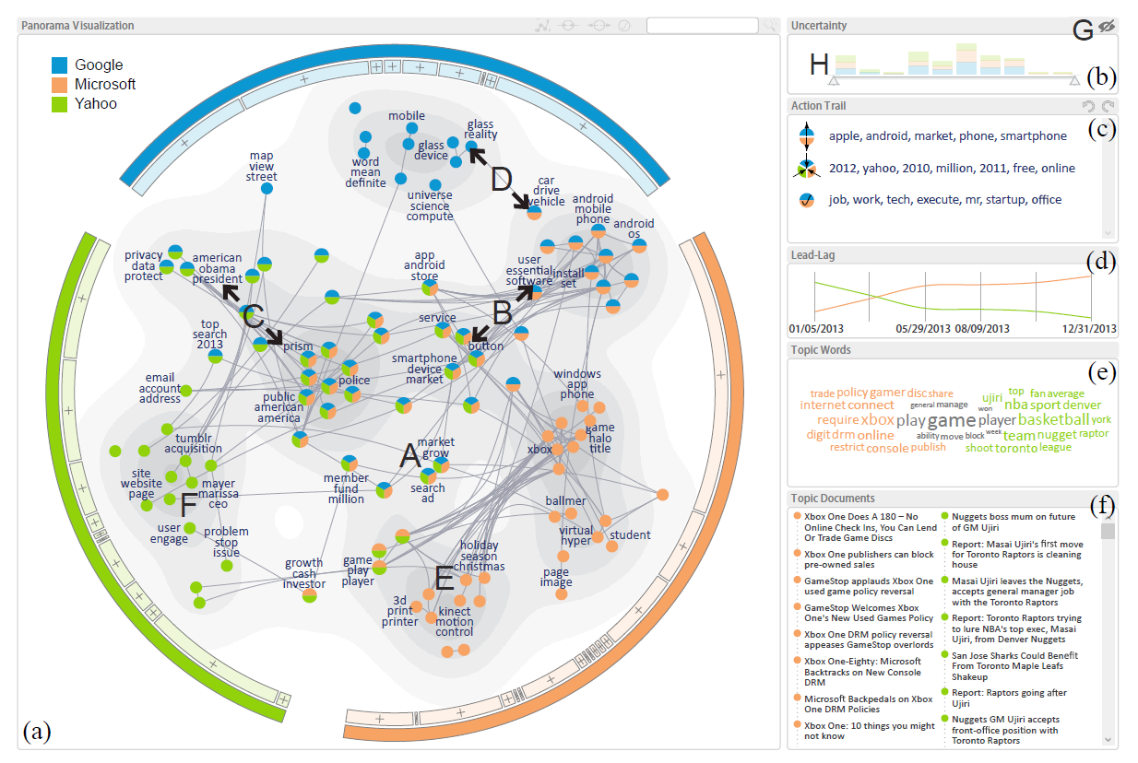
(Interactive) Visualizations
Topic-Oriented
Time-Oriented
Termite (Chuang et al 2012)
LeadLine (Dou et al 2012)
Hierarchical
Graph (Relational) Based
HierarchicalTopics (Dou et al 2013)
TopicPanorama (Wang et al 2016)

Slide 16
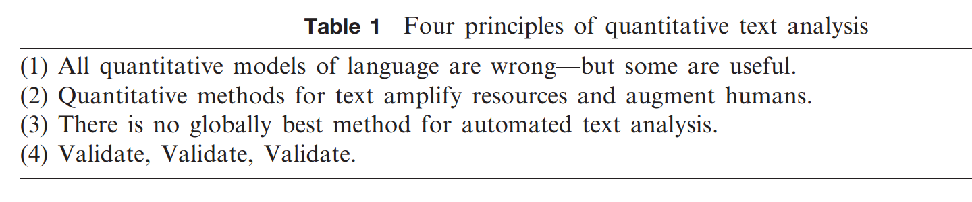
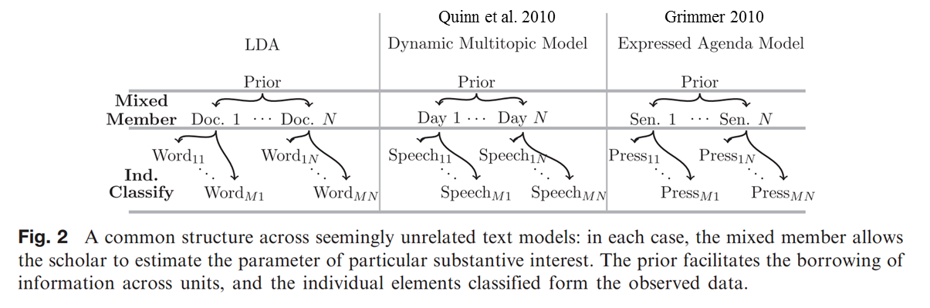
Social Science Applications
Grimmer and Stewart 2013
Structural Topic Model (STM) is the most significant contribution to topic model research by social scientists, providing a general framework for incorporating metadata (covariates) for hypothesis testing (Roberts et al. (2013, 2014)).
Notes:
Early approaches
Approach
Issues Raised and Solved?
Multi-modality
Grimmer and Stewart (2013)
Quinn et al. (2010) and Grimmer
Grimmer
16

Slide 17
Structural Topic Model (STM)
STM is a generalization of LDA
Created by social scientists (political scientists)
Extends Roberts et al (2013); Roberts et al (2014)
Incorporates document metadata (covariates) into “GLM”
Two types of covariates: prevalence (what) and content (how)
Oversimplification: Y_{Topics} = Constant + b_{p} * X_{prevalence} + b_{c} * X_{content}
R package (stm) using fast Variational EM
Handles multimodality issues (spectral initialization)
Add-ins for topic interpretations (FREX) and model selection

Slide 18
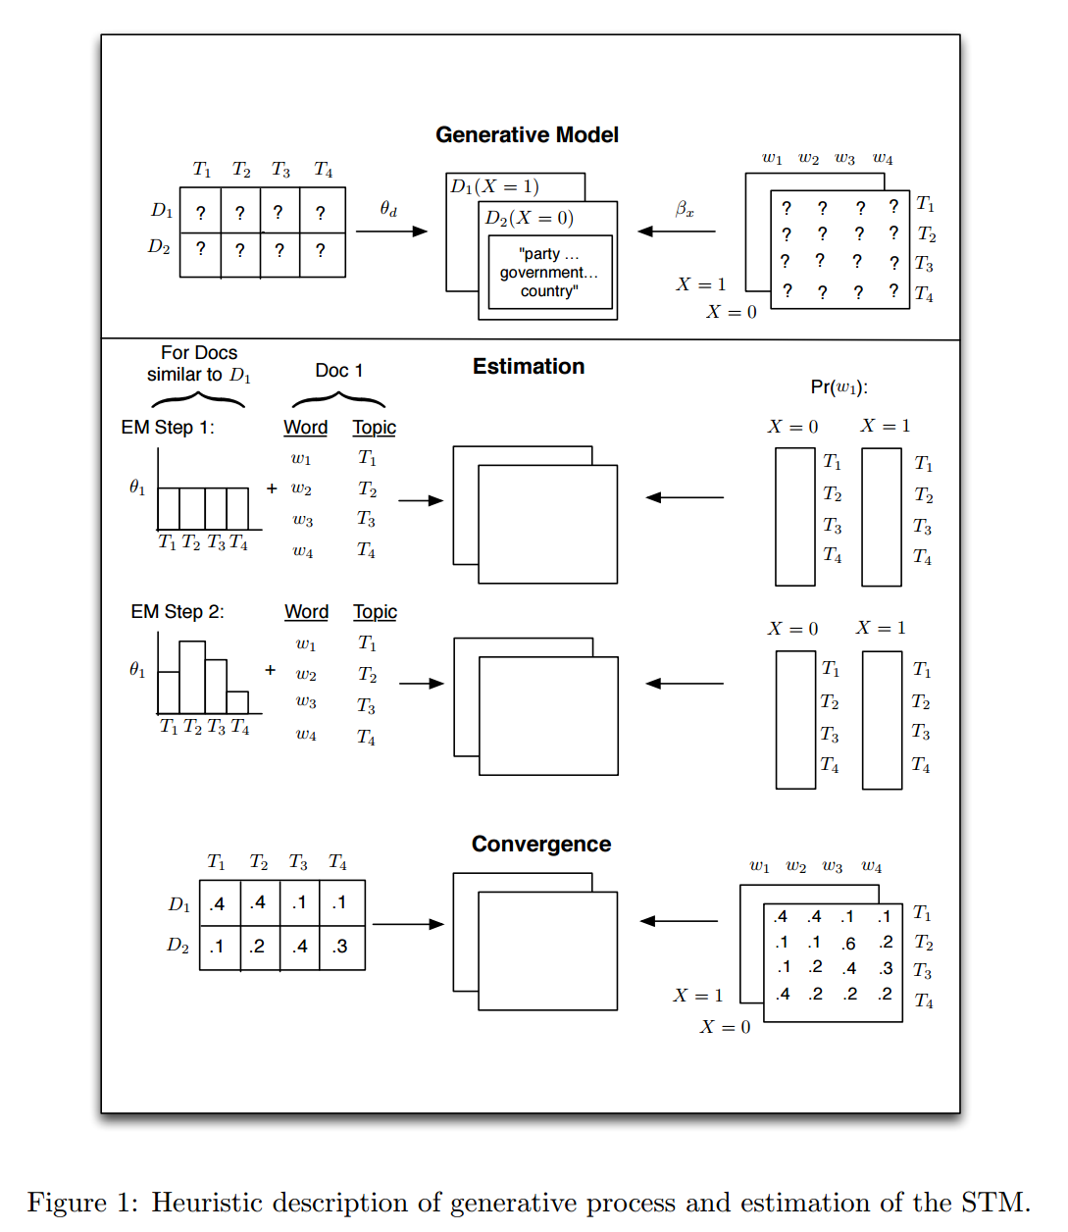
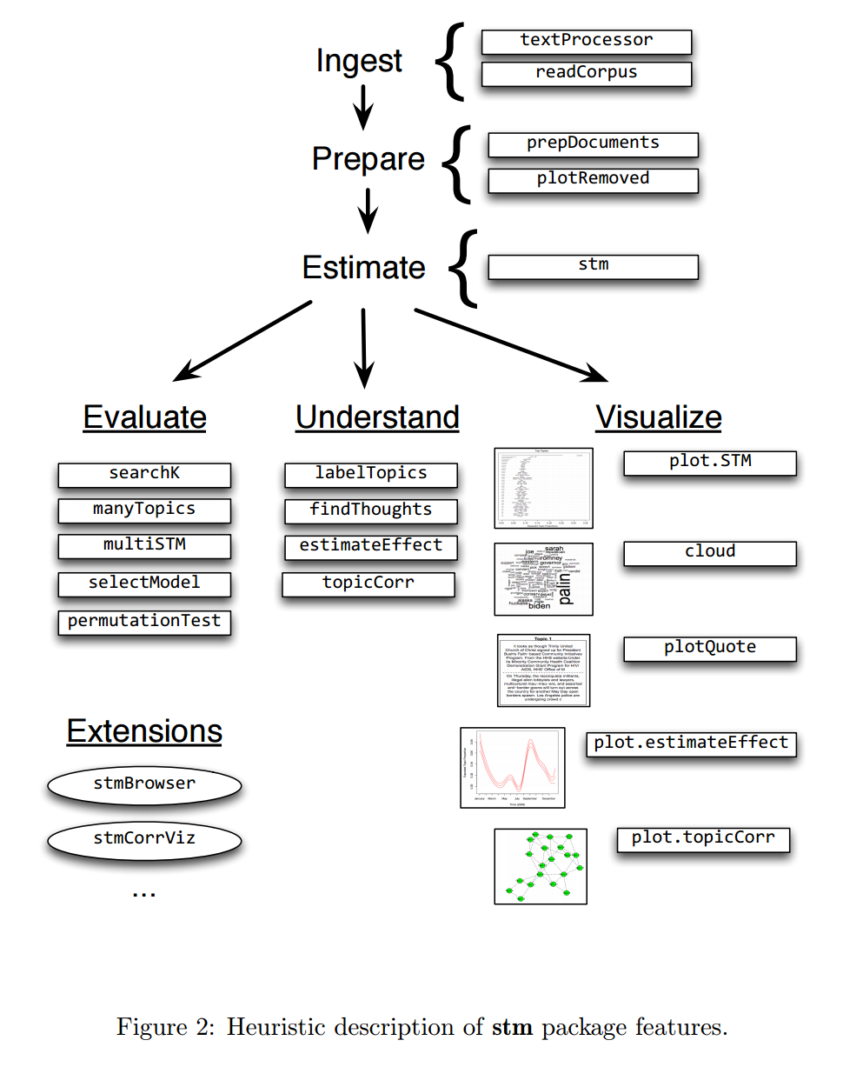
Structural Topic Model

Slide 19
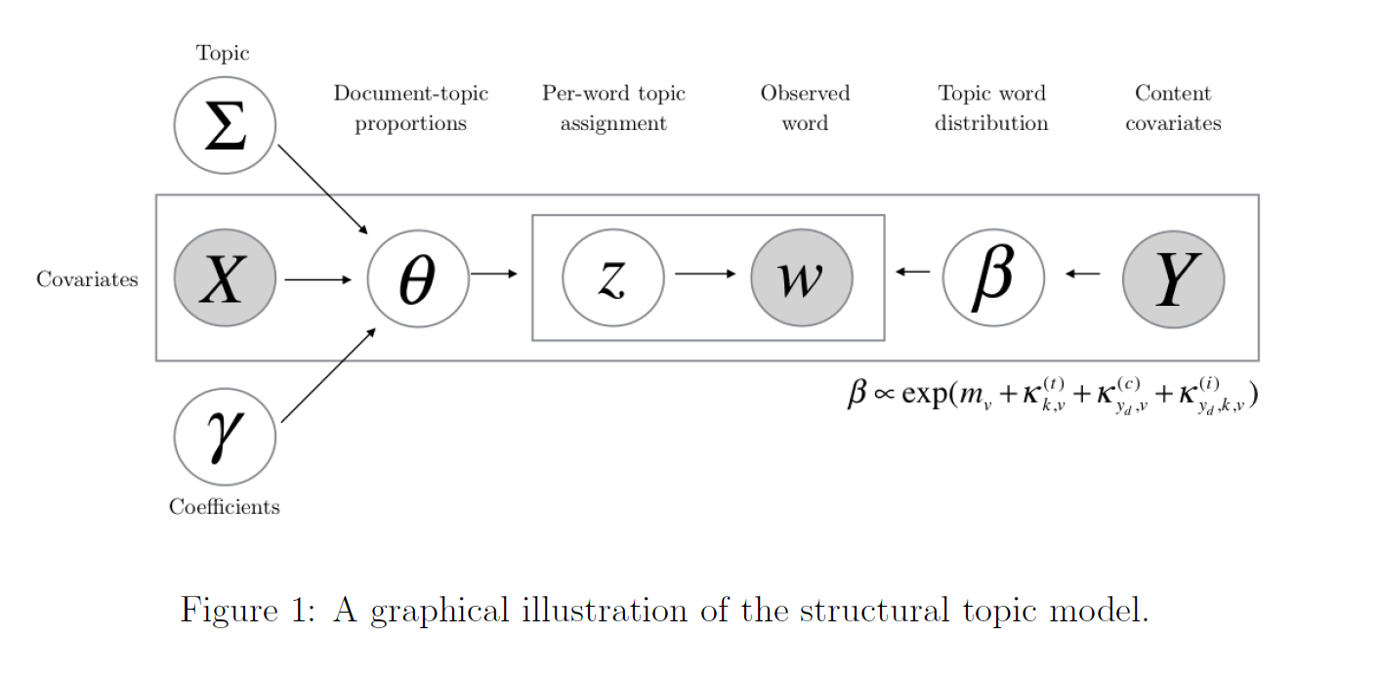
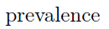
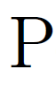
STM: Graphical Model
Correlated Topic Model (Blei & Lafferty, 2007)
Allow topic correlation structure
SAGE (Eisenstein et al., 2011)
Topic-word computational approximation
Covariates that impact “how” topics (content)
Dirichlet-Multinomial Regression (Mimno & McCallum, 2008)
Covariates that impact “what” topics (prevalence)

Slide 20
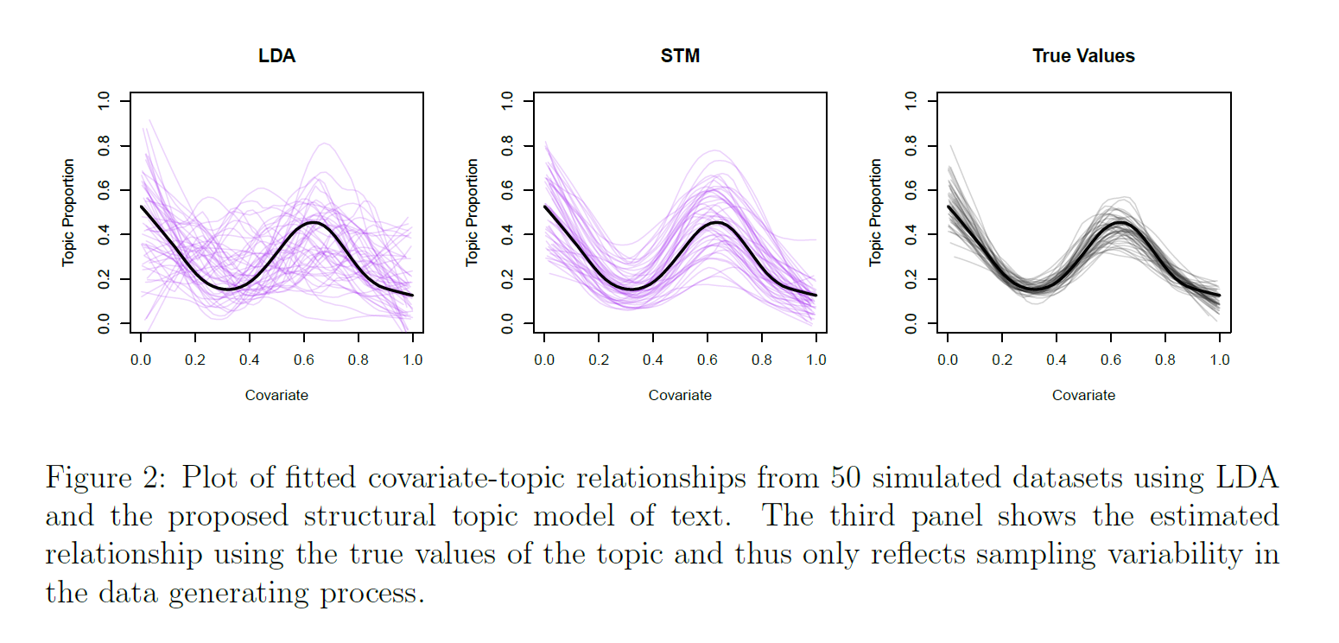
Performance on Simulated Data
On average good; but high variance
Better captures covariate relationship

Slide 21
Performance on Holdout Sample
Higher Values => Better holdout prediction

Slide 22
Application: Media Slant on China
Western and Chinese media slant on China’s Rise
Sample of 11,980 (English) news articles containing the term “China” between 1997 and 2006
Five different international news sources
AFP (France), AP (USA), BBC (British), JEN (Japan), XIN (China)
Run 100 topic STM model
Prevalence covariates: Time (month) and News Source
Content covariate: News Source

Slide 23
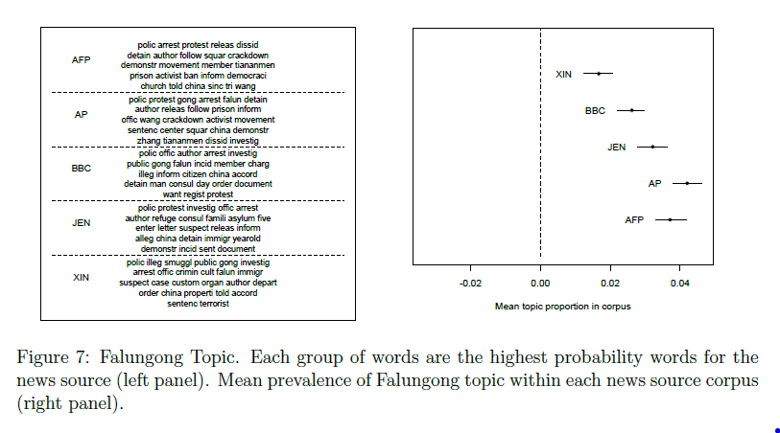
Findings: Content & Prevalence
AP / AFP covered topic more often than Xinhua
“Demonstration”
“Criminal”

Slide 24
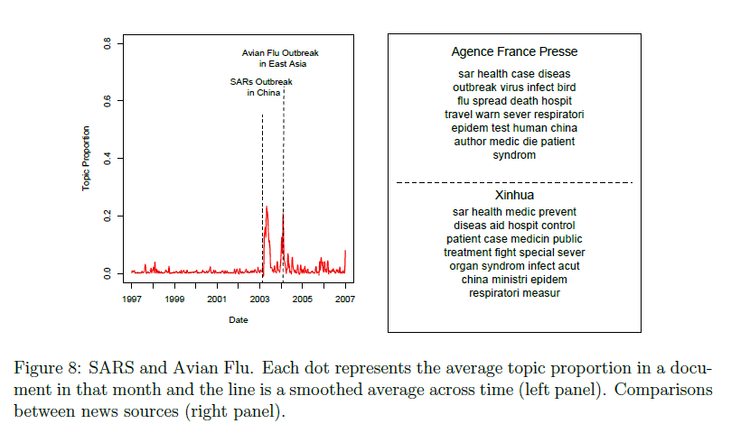
Findings: Time as a Prevalence Covariate

Slide 25
Big Picture: Future Research

Slide 26
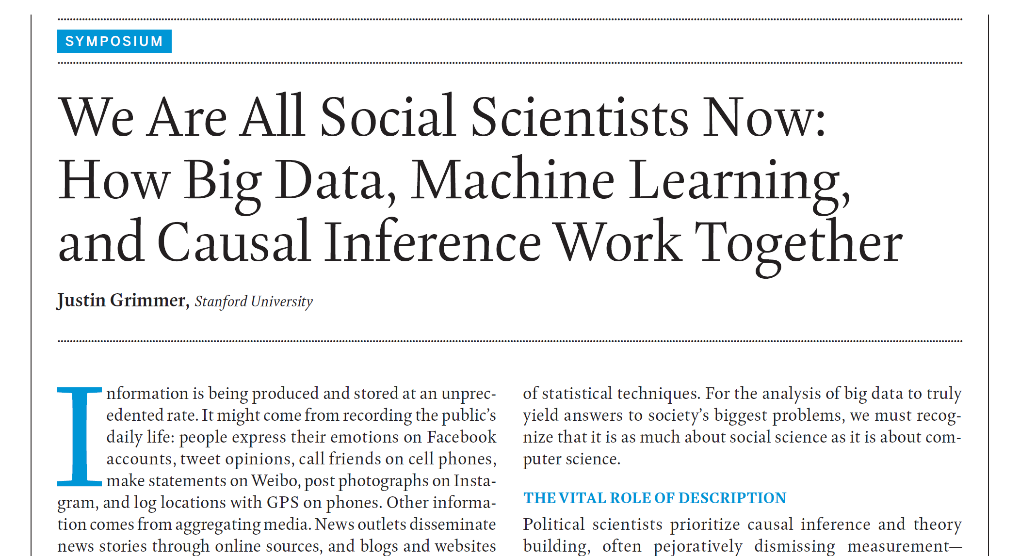
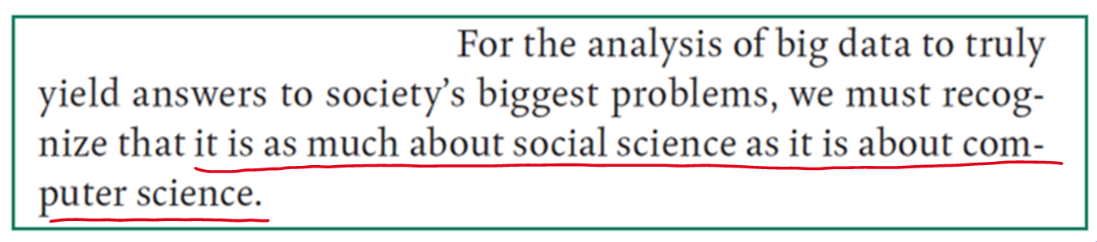
Computational Social Science
Notes:
“Social scientists know that large amounts of data will not overcome the selection
problems that make causal inference so difficult.”
26

Slide 27
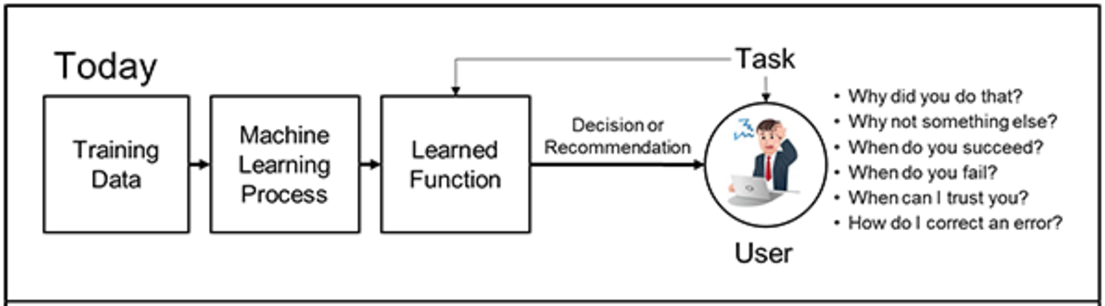
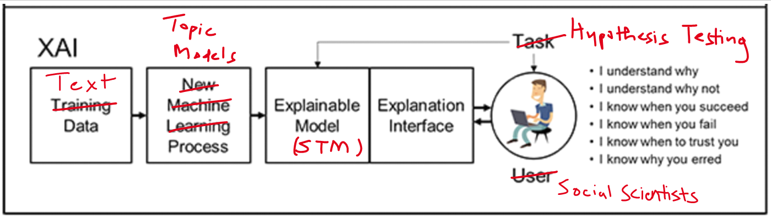
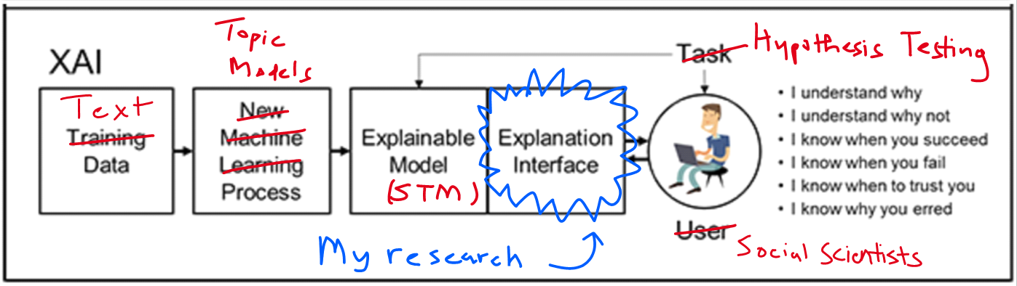
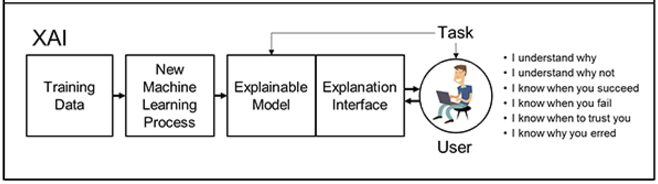
Possible Research: Explainable AI
Source: DARPA-BAA-16-53

Slide 28
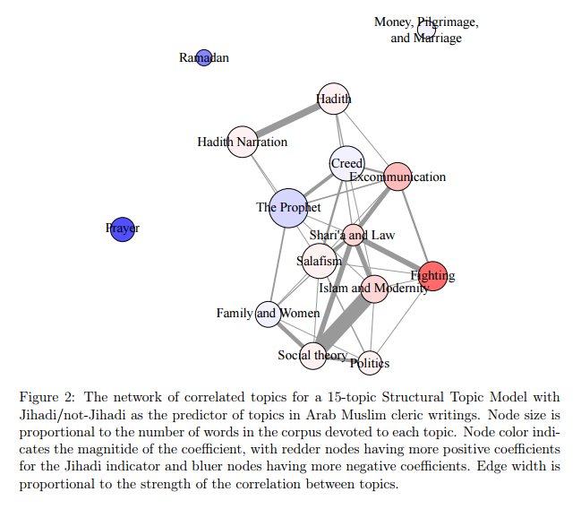

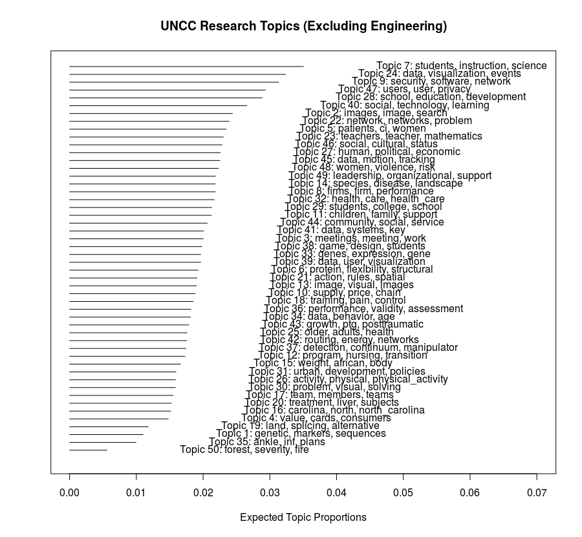


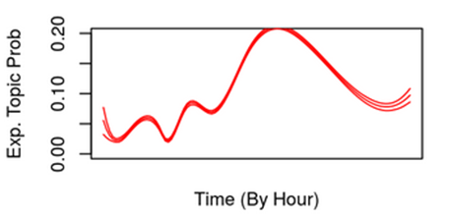

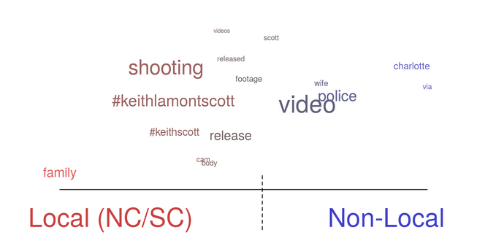
Thank you! Questions?

Slide 29
Appendix

Slide 30
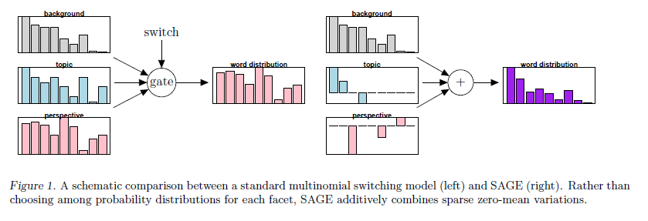
SAGE Model: Eisenstein et al. (2009)

Slide 31
Structural Topic Model Application
Lucas et al. (2015) analyze Arabic fatwas (writings) by 101 prominent Muslim clerics.
One of the first applications of Structural Topic Model
Use Jihadi (binary) flag as a covariate
Jihadi flag from two Islamic scholars (experts)
Research Question:
Do Jihadi clerics talk about different topics than non-Jihadi clerics?

Slide 32
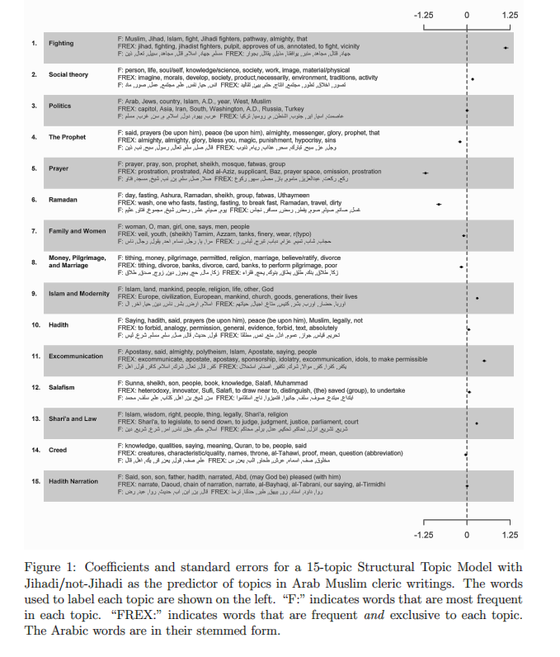
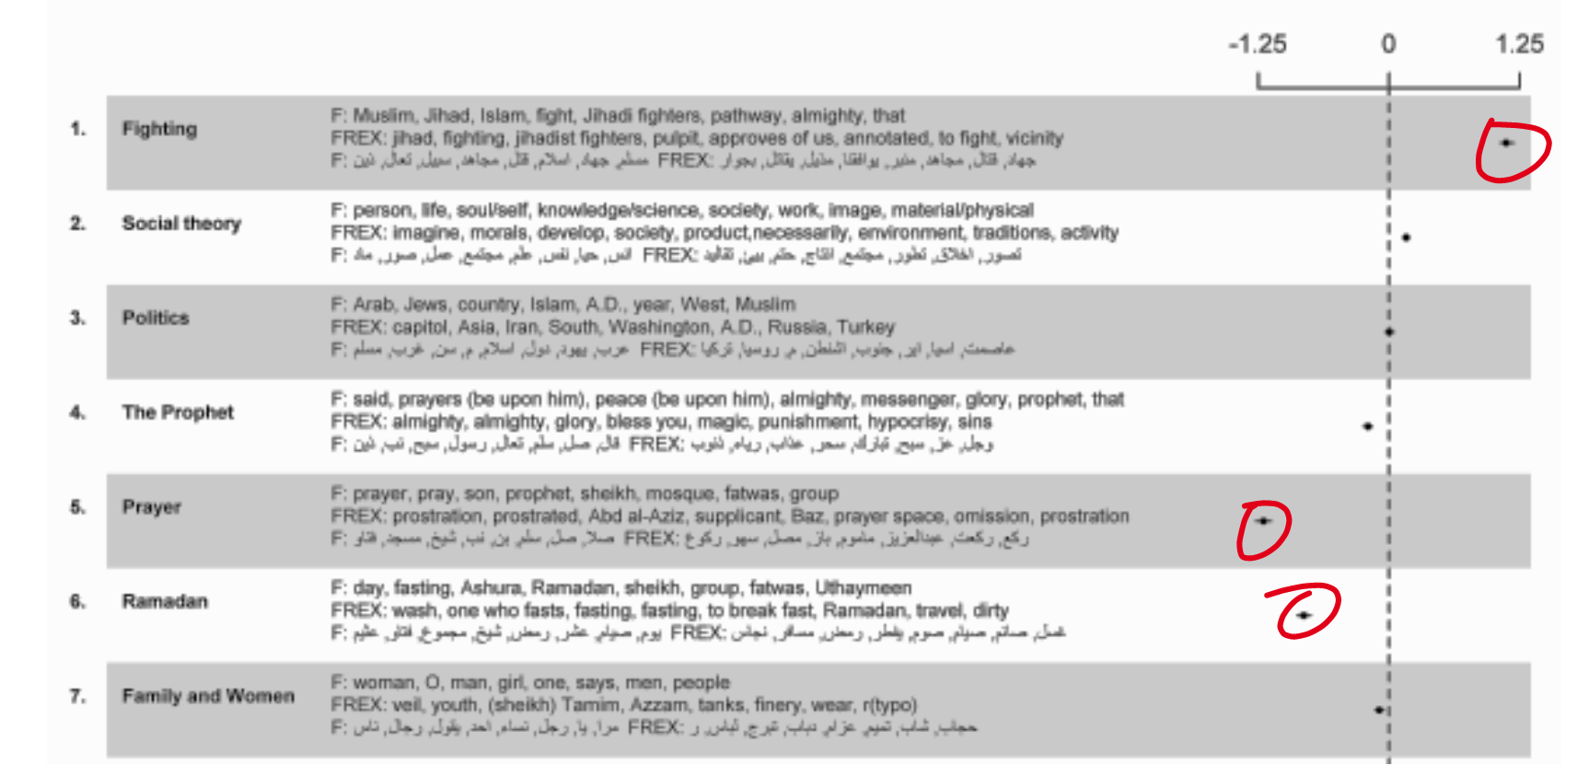
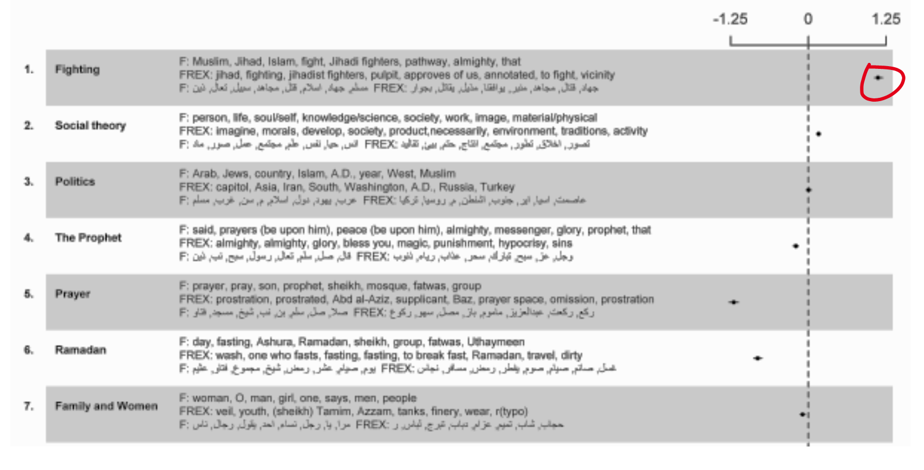
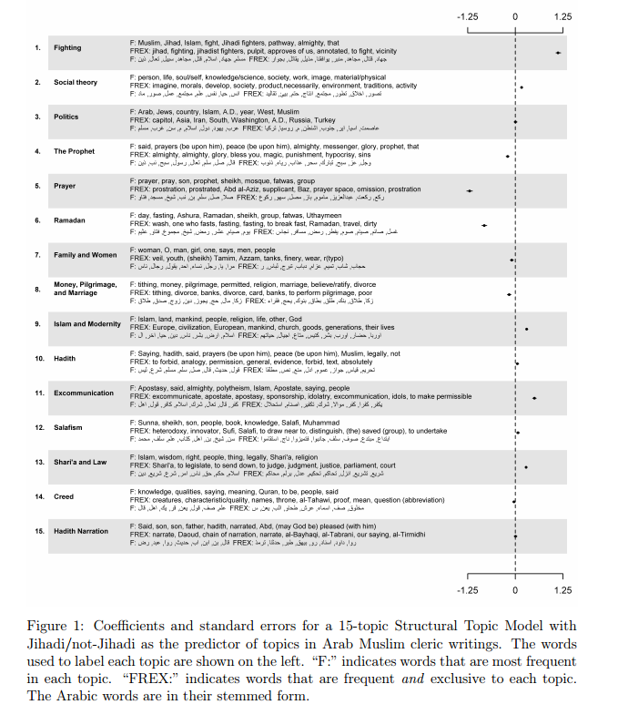
Fatwa Topics by Jihadi/Non-Jihadi clerics

Slide 33
Conclusions
Advantages:
Statistical “GLM” framework for document metadata
Facilitates “hypothesis testing”
Handles non-linearity, interactions
Fast computational methods
Variational Expectation-Maximization
stm R package
Handles multimodality (spectral initialization)
Built-in tools for interpretation and model selection (# of topics)
Limitations:
Problems with a large number of covariates.
Difficult to scale the model
Output is very large; difficult to analyze
Need for interactive visualizations to analyze model output
My research goal: Build out interactive visualizations to analyze STM’s results.

